Slide 1

Data Warehouse Design Proposal
Data Engineering Task - Bosch Thermotechnik GmbH
Amparo Iglesias
21.04.2025

Slide 2
Data Model Concept Proposal
Based on a dimensional star schema, supporting fast analytical queries and actionable business insights.
Fact Tables
Dimension Tables
Fact_Orders: Tracks sales, pricing, and quantities
Dim_Customer: Customer details and types
Fact_Delivery: Captures delivery schedules, actuals, and delays
Dim_Product: Product names and base prices
Dim_Delivery: Delivery dates and times
Dim_Order: Order dates and status
Fact Tables are closely linked to dimension tables, and store the key business metrics
Dimension Tables provide descriptive context for facts

Slide 3
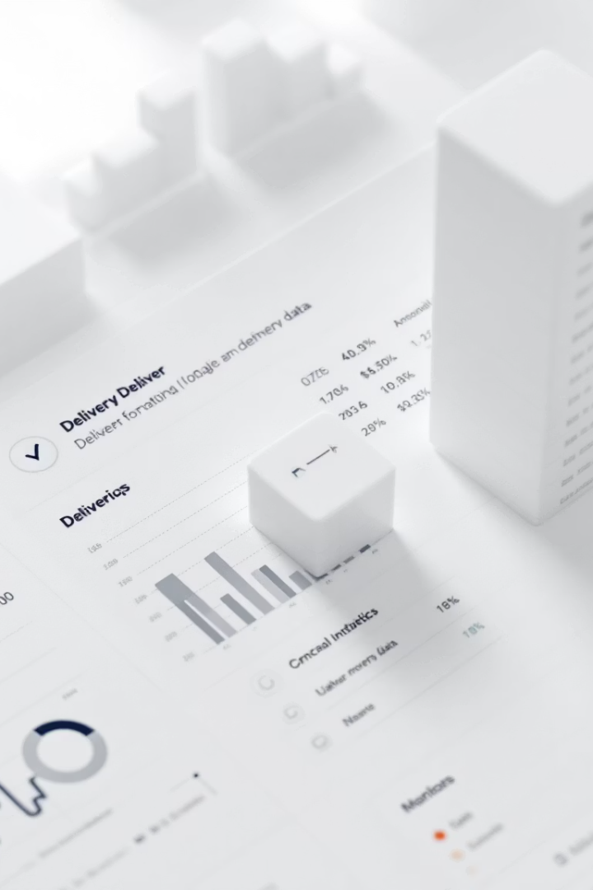
Fact Tables
Orders & Deliveries
Fact_Orders
Fact_Delivery
Order ID, Customer ID, Product ID
Delivery ID, Scheduled/Actual Dates
Quantity Ordered, Gross/Net Price
Delay in Minutes
On-Time Delivery (Yes/No)
Total = Quantity × Net Price
Business Insights
Most sold products
Average prices
Revenue per customer
Logistics performance

Slide 4





Dimension Tables
Dim_Customer
Dim_Product
Dim_Delivery
Customer ID, Name, Type
Material ID, Product Name, Base Price
Delivery ID, Date, Time, Day of Week
Dim_Order
Order ID, Order Date, Status

Slide 5




Layered Data Warehouse Architecture
Transformation Layer
Source Layer
1
2
Joins, cleaning, and metric calculations
Raw data from Excel and FTP
Presentation Layer
4
3
Data Warehouse Layer
BI tools for reporting and insights
Star schema tables for analytics

Slide 6
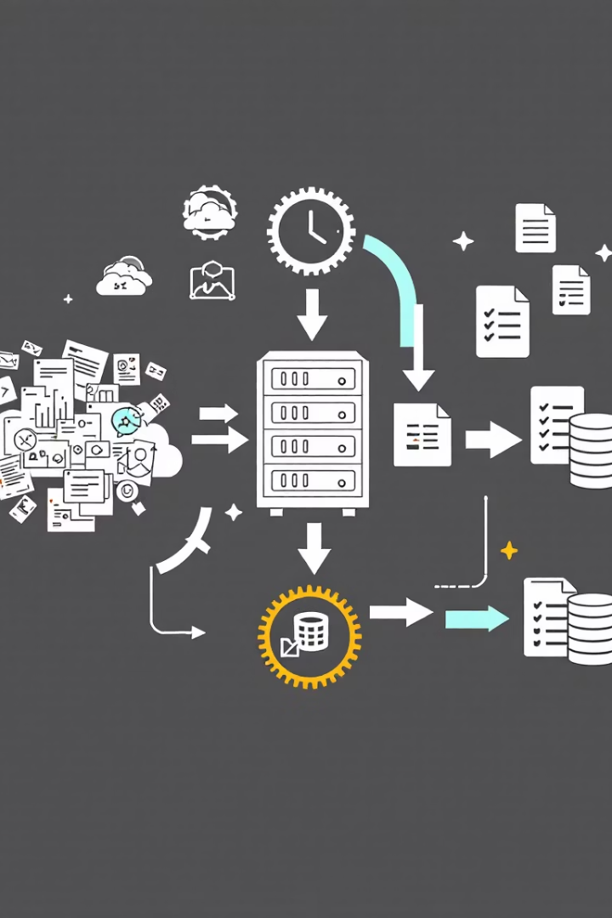
Data Integration & Transformation
1
Raw Ingestion
Collect Excel and FTP data
2
Data Cleaning
Normalize formats, resolve inconsistencies
3
Joins & Calculations
Link orders, deliveries, and confirmations
4
Star Schema Build
Populate fact and dimension tables

Slide 7

Key Challenges in Implementation
Data Integration
Date/Time Consistency
Combining Excel and FTP data with different formats
Resolving mixed date formats across systems
Order-Delivery Linking
Pricing & Missing Data
Handling deliveries with multiple order lines and partial fulfillment
Ensuring accurate net price and addressing incomplete records

Slide 8

Open Questions & Next Steps
Data Refresh Frequency?
Determine ETL schedule: daily, hourly, or event-based
BI Tool Selection?
Choose platform for dashboards and reporting
Business Logic Decisions?
Define handling of partial/undelivered orders and regional analysis
Route Optimization?
Create methods to improve delivery efficiency

